Slide 1

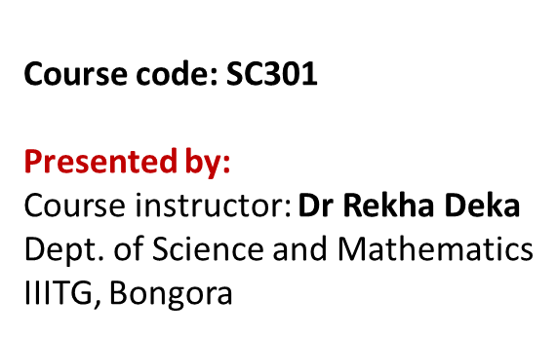
Unit IV- Human physiology Respiratory System
Contents | Slide No.
Main functions of Respiratory system | 2
2. Organs of respiratory system | 3-4
3. Respiration process and its events | 5
4. Pulmonary ventilation /Breathing an inhalation process | 6-7
5. External respiration and Internal respiration | 8
6. Pulmonary exchange of gases and systemic exchange of gases | 9-10
7. Transport of respiratory gases- oxygen and carbon dioxide | 11-13
8. Oxygen release and carbon dioxide picks up at the tissues (Gas exchange at tissues)…………….CHLORIDE SHIFT | 14
9. Oxygen-haemoglobin dissociation curve (Bohr effect) | 15-16
10. What is hypoxia and respiratory centre | 17-19

Slide 2
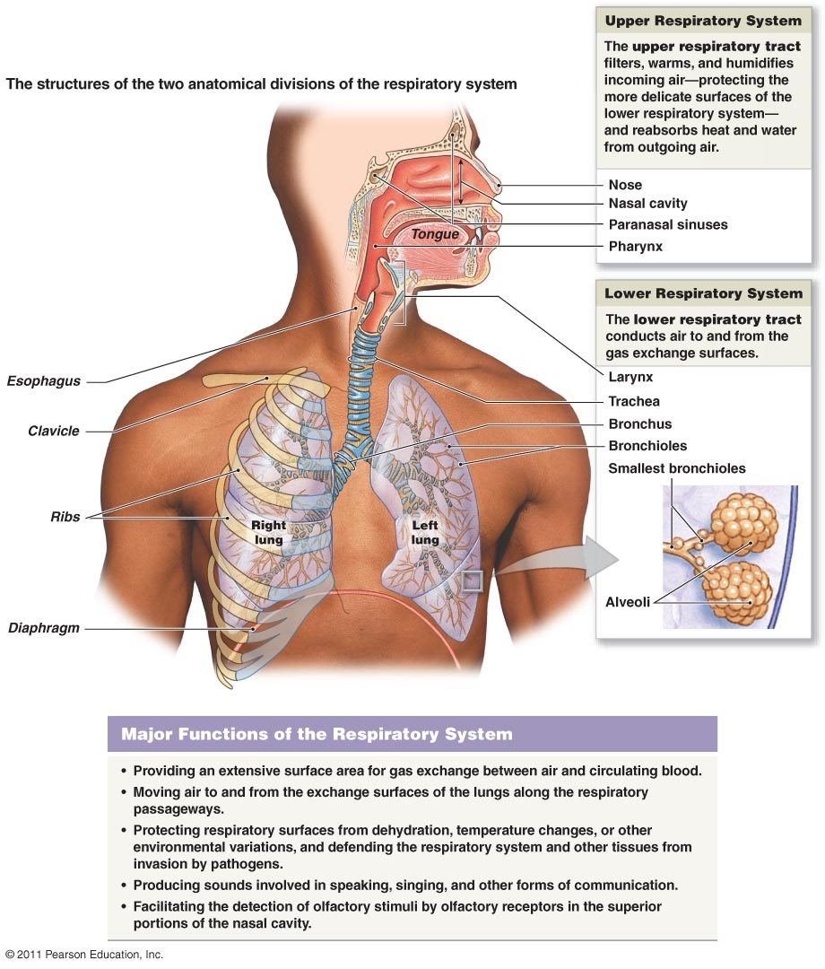
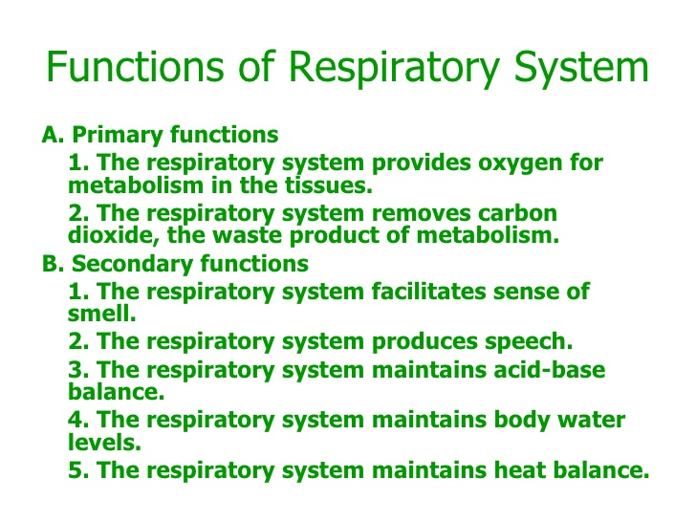
Main functions of Respiratory System
Helps regulate blood pH

Slide 3
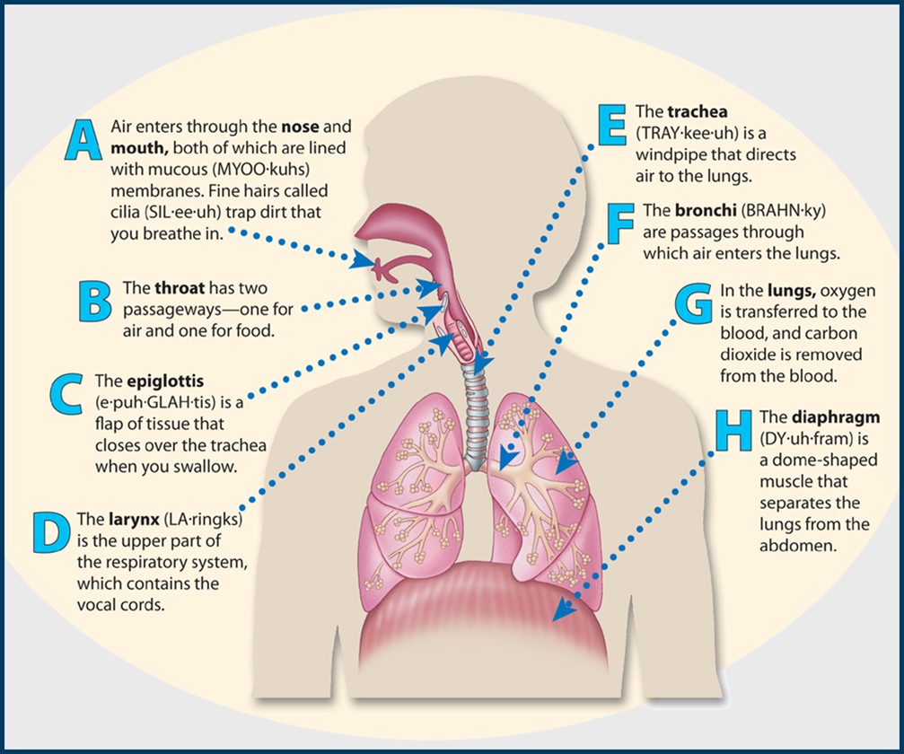
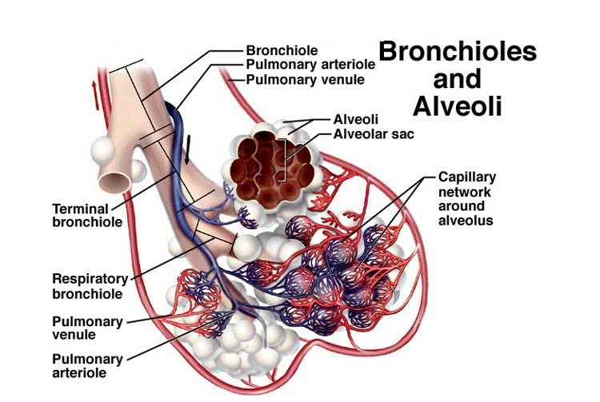
Functional division of respiratory system
Organs of Respiratory System and its functional division (conductive and respiratory zone)
Two parts:
Conductive zone: main function is to filter, warm, and moisten air and conduct it into the lungs. These include nose, nasal cavity, pharynx, larynx, trachea, bronchi.
Respiratory zone: main sites for gas exchange between air and blood. These include bronchioles, alveolar ducts, alveolar sacs and alveoli.

Slide 4
Organs in the Respiratory System
Organs | Function
nose / nasal cavity | warms, moistens, & filters air as it is inhaled
pharynx (throat) | passageway for air, leads to trachea
larynx | the voice box, where vocal chords are located
trachea (windpipe) | trachea is lined with fine hairs called cilia which filter air before it reaches the lungs
bronchi | two branches at the end of the trachea, each lead to a lung
Lungs bronchioles | a network of smaller branches leading from the bronchi into the lung tissue & ultimately to air sacs
alveoli | the functional respiratory units in the lung where gases are exchanged
Diaphragm | A dome-shaped muscle that separates the lungs from the abdomen
Conductive zone
Respiratory zone

Slide 5
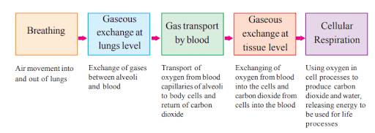

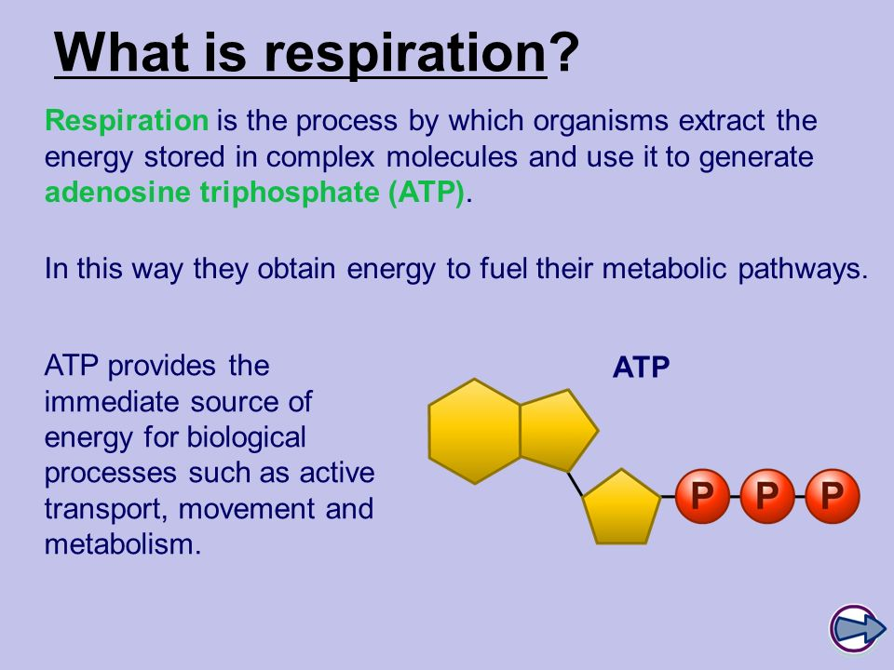
Respiration process and its four events
Pulmonary ventilation
External respiration or pulmonary exchange of gases
Respiratory gas transport
Internal respiration or Systemic exchange of gases

Slide 6
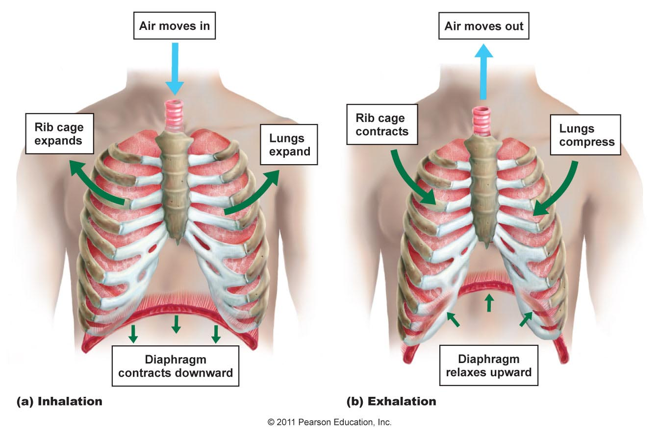
Pulmonary Ventilation/Breathing
1. Pulmonary ventilation is a mechanical process depends on volume changes in the thoracic cavity. Volume changes lead to pressure changes, which leads to the flow of gases to equalize pressure.
2. Two phases of pulmonary ventilation/breathing
Inspiration, and
Exhalation
Inspiration: During inspiration (inhalation), the diaphragm and intercostal muscles contract due to which there is expansion of rib cage and lungs and increase in thoracic cavity. External air is pulled into the lungs due to increase in the volume of thoracic cavity.
Exhalation: During exhalation, these intercostal muscles relax. The diaphragm relaxes and moves upwards due to which rib cage contracts and lungs are compressed. As a result air is pushed out of the lungs.

Slide 7
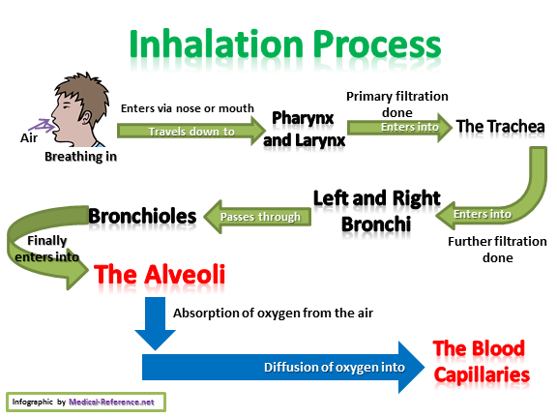

Slide 8
External Respiration and Internal Respiration
1. External respiration / Pulmonary exchange of gases is the exchange of gases between oxygen in the air and blood capillaries in the alveoli. Diffusion of gases between lungs-alveoli and blood.
Oxygen diffuses from alveoli into blood.
Carbon dioxide simultaneously diffuses in opposite direction.
Blood has low PO₂ (40 mm Hg) while PO2 in air is 104 mmHg.
Blood has high CO₂ (45 mmHg) compared to alveoli air (40 mm Hg).
2. Internal respiration / Systemic exchange of gases is the exchange of gases between blood and body tissues. Cells use oxygen constantly for cellular respiration so partial pressure in tissue is low. Tissue produce large quantities of CO₂ as biochemical waste products so partial pressure is high.

Slide 9
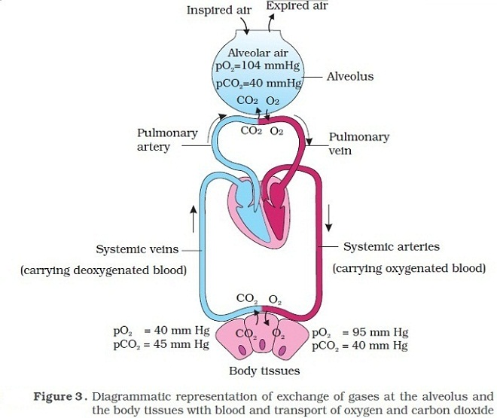
Pulmonary exchange of gases (between lungs and blood) and Systemic exchange of gases (between blood and body tissues)

Slide 10
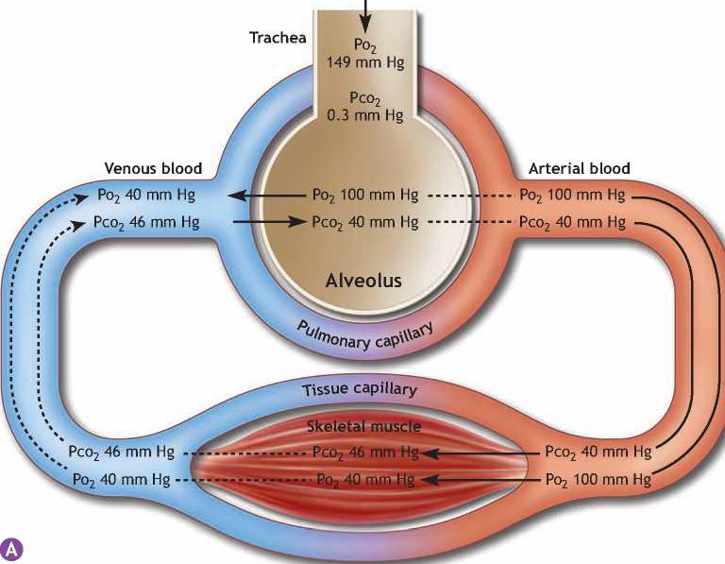
Gas exchange

Slide 11
Transport of respiratory gases
1) Oxygen transport
2) Carbon-dioxide transport from tissues to lungs

Slide 12
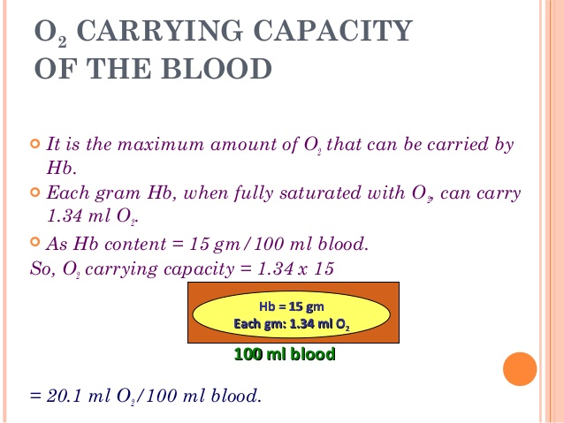
Transport of respiratory gases in the blood
Oxygen transport
1. O₂ + Fe²⁺ -Haemoglobin (Hb) → HbO₂ (oxyhemoglobin)---98.5%
2. Oxyhemoglobin carries 1-4 molecules of oxygen depending on its degree of saturation.
3. Oxyhemoglobin does not dissociate in the blood vessel, until it reaches a tissue with low Po₂ (partial pressure of oxygen).
4. In dissolved state, only 3% oxygen is transported to the tissues.

Slide 13
Carbon-dioxide transport from tissues to lungs
In dissolved state in plasma-5-7% is transported in dissolved state. Upon reaching the lungs, it diffuses into alveolar air and exhaled.
2. Bicarbonate ions: 70% CO₂ is transported in the form of bicarbonate ions.
CO₂ (from tissues) + H₂O (water in erythrocytes) ⇔ H₂CO₃ (Carbonic acid) reaction is catalyzed by enzyme Carbonic anhydrase which is present in erythrocytes.
H₂CO₃ ⇔ H⁺ + HCO₃⁻⁻ Carbonic acid that is formed immediately dissociates into Bicarbonate ions (HCO₃⁻⁻ ). Bicarbonate ions diffused into the plasma and reacts with sodium ions to form sodium bicarbonate (NaHCO₃⁻). In exchange of HCO3-, chloride ions move from plasma into the RBCs. This exchange of negative ions, which maintains the electrical balance between blood plasma and RBC cytosol, is known as chloride shift.
3. Carbamino-haemoglobin- 23% of CO₂ reacts with amine group of globin part of haemoglobin (Hb) forming carbamino-haemoglobin (HbCO₂)

Slide 14
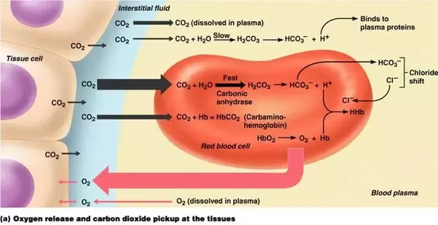
Oxygen release and carbon dioxide picks up at the tissues (Gas exchange at tissues)
Haemoglobinic acid (HHb), helps in buffering excess H⁺ ions and allowing O₂ to be released

Slide 15
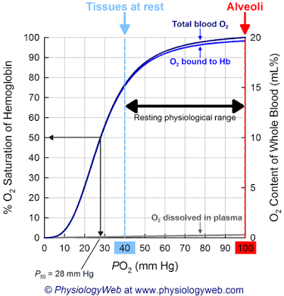
Oxygen-haemoglobin dissociation curve showing the relationship between hemoglobin saturation and Po₂ at normal body temperature
1. When Po₂ is high, the more O₂ combines with hemoglobin and is almost 100% saturation.
2. When Po₂ is low, hemoglobin is only partially saturated.
3. In pulmonary capillaries, where Po₂ is high, a lot of O₂ binds to hemoglobin. In tissue capillaries, where the Po₂ is lower (40 mm Hg), hemoglobin does not hold as much oxygen and dissolve Oxygen is unloaded via diffusion into tissue cells.
4. Hemoglobin is still 75% saturated with O₂ at a Po₂ of 40 mm Hg, the average Po₂ of tissue cells in a person at rest. That means only 25% of the available O₂ unloads from hemoglobin and is used by tissue cells under resting conditions.

Slide 16
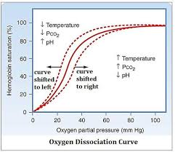
Factors that causes shifts in the ODC - left and right shift
Bohr effect or oxygen dissociation curve

Slide 17
What is hypoxia?
Hypoxia: Its a deficiency of O₂ at the tissue level that may be caused by following ways:
Hypoxic hypoxia: Low Po₂ in arterial blood, as from high altitudes, airway obstruction.
Anaemic hypoxia: Too little functioning hemoglobin in the blood that reduces O₂ transport to tissue cells.
Ischemic hypoxia: Inability of the blood to carry O₂ to tissues fast enough to sustain their needs, as in heart failure. Po₂ and oxyhemoglobin levels are normal
Histotoxic hypoxia: Inability of tissues to use O₂ properly, as in cyanide poisoning. Cyanide blocks an enzyme required for the use of O₂ during ATP synthesis.

Slide 18
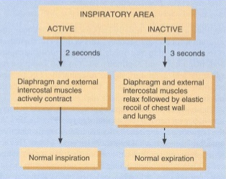
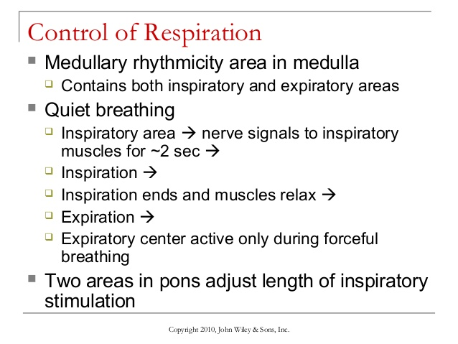
Respiratory centre
1) The basic rhythm of respiration is controlled by groups of neurons in the brain stem.
2) The area from which nerve impulses are sent to respiratory muscles is called the respiratory center and consists of groups of neurons in both the medulla oblongata and the pons.
Medulla oblongata…… inspiratory areas and expiratory areas.
Pons……..pneumotaxic area and apneustic area
3) The inspiratory area sets the basic rhythm of respiration.

